Slide 1
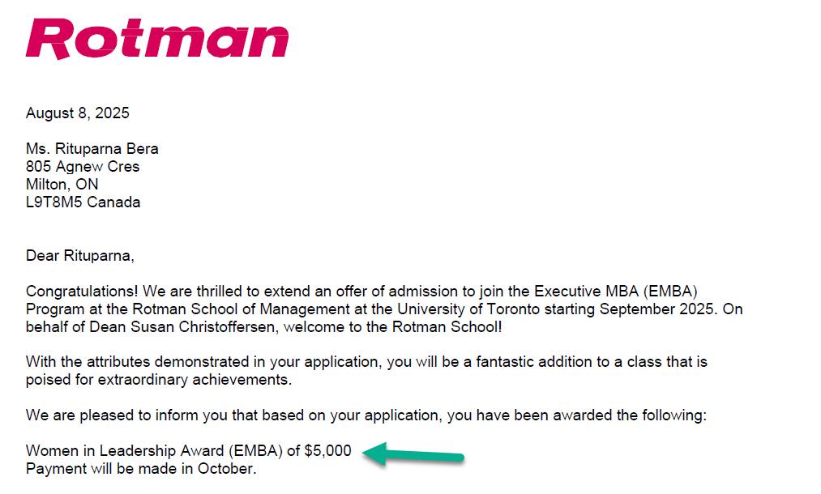
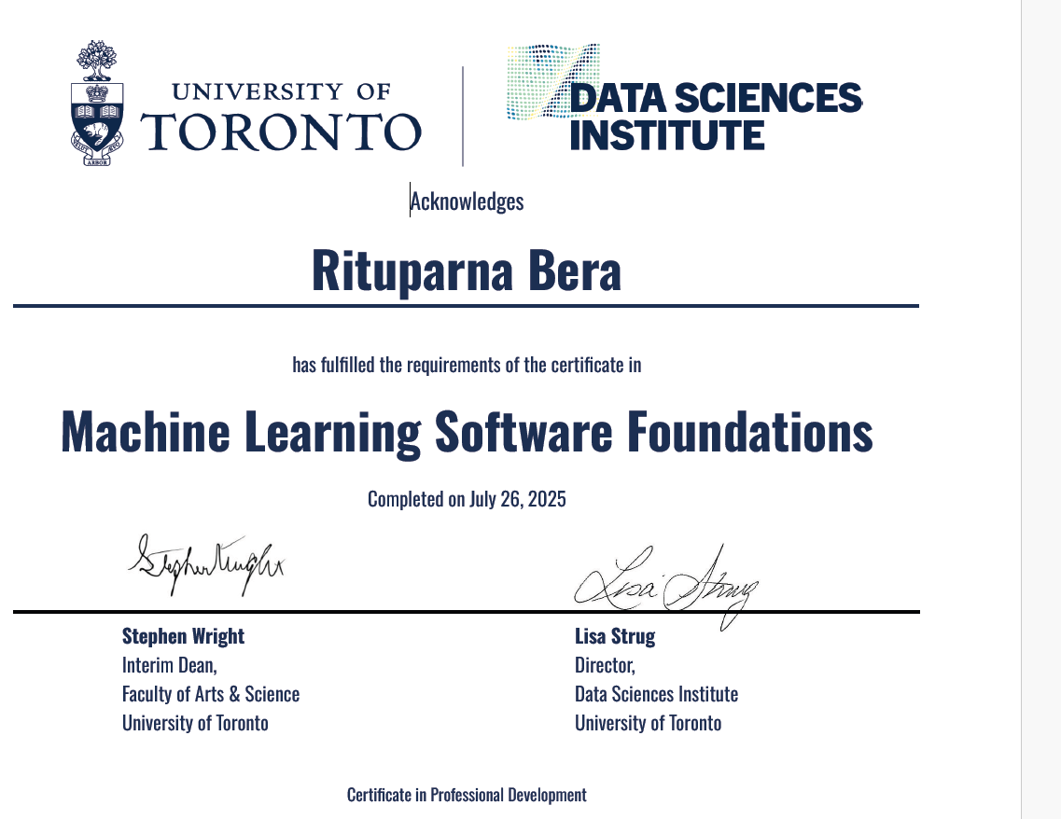
Profile Summary
Experience- 18 years of IT exp. - 7 years at IBM. - 10 + years at TD Bank
Certifications– - Certified Scrum Product Owner (CSM and CSPO) - Project Management Professional (PMI PMP) - Microsoft Azure Fundamentals - UiPath Test Automation Engineer - Blue Prism Designer AD 01 - Foundation of Machine Learning University
I bring 18+ years of IT experience, including 10+ years at TD Bank in data engineering, APIs, ETL, and automation, with a Bachelor’s degree in Statistics (Honours) and a strong mathematics foundation. I am a recent graduate of the University of Toronto’s Machine Learning Software Foundations program (2025) and a recipient of the Rotman Women in Leadership Award (EMBA 2025–2027).
In my career, I have consistently bridged deep technical execution with strategic business impact, delivering high-value analytics, automation, and AI solutions in complex banking environments.

Slide 2
Journey – my 10+ Years at TD
MBNA Customer Integration (2013–2014) – Unified customer data into a ‘golden copy’ for analytics, compliance, and personalization.
MBNA Visa Launch (2014–2018) – Led API/SOA testing ensuring compliance and dual-network capability with minimal disruption.
Wealth Data Strategy – DPP (2018) – Built scalable pipelines (Spark, Solace, SQL Server) for standardized, real-time data delivery.
Wealth Data Strategy – Security Master (2018) – Delivered unified, high-quality investment instrument data; automated validation.
DIY/Robo – WIPP (2019) – Enabled self-serve goal tracking MVP; ensured scalable and reliable architecture.
Wealth Service Request (2019–2021) – Streamlined multi-channel processing; built reusable UI components for efficiency.
Wealth Money Movement (2019–2021) – Automated transfers, FX, deposits, and withdrawals; enhanced monitoring and risk control.
CPAM – Client Profile & Account Maintenance (2021–2022) – Replaced legacy UI; integrated compliance data capture for onboarding.
Robotic Process Automation Lead (2022–Present) – Designed enterprise-grade RPA testing frameworks; achieved 95%+ success rate and reduced regression cycles by 30%.

Slide 3
How I Operate
Clear, measurable goal-setting through OKRs and KPIs
- Delivered 95%+ success rate in RPA automation
- Drove 40% faster regression cycle through RPA process optimization
- Conducted monthly OKR reviews with leadership to track team progress
- Coached 5+ junior team members toward promotion readiness

Slide 4
What Uniqueness I Bring
Rare blend of technical depth & strategic vision — 18+ years in automation, AI, and digital transformation in financial services.
Complexity into clarity — translating intricate data, ML models, and automation workflows into actionable business insights.
Hands-on foundation — built RPA, ETL, API, and Software teesting frameworks impacting thousands of users.
Strategic AI alignment — focus on governance, ethics, and integrating AI into enterprise strategy.
Cross-functional connector — bridging data science, business priorities, compliance, and product strategy.
Proven leadership — led teams, delivered on OKRs, mentored engineers, and driven enterprise-wide change.
Unique perspective — bringing real-world AI application in banking, scaling digital transformation, and diverse leadership experience as a mid-career, Indian-origin woman in tech.

Slide 5
Key Technical Achievements
Customer Data Expertise – Led the MBNA Customer Integration project, managing ETL processes to create an enterprise “golden copy” of customer data for analytics, compliance, and personalization.Advanced
Analytics & ML – Skilled in Python (Pandas, NumPy, Scikit-learn) and SQL for data analysis, model building, and automation; proficient in Tableau for visual storytelling.
Business-Driven Insights – Translated complex datasets, ML models, and automation workflows into actionable strategies that improved customer engagement and revenue growth.
Leadership & Collaboration – Led cross-functional teams, mentored engineers, and partnered with compliance, product, and business units to ensure AI solutions aligned with governance and ethics.
RPA Innovation – Designed and delivered automation solutions using digital workers (bots) to handle repetitive, rule-based tasks, achieving high accuracy and freeing employees for higher-value work.

Slide 6
Leadership & Strategic Impact
Led cross-functional teams delivering enterprise-scale solutions in Agile environments.
Mentored junior engineers; championed best practices in automation and testing.
Connector between business and technology – translating complexity into actionable strategy.
Driving AI-driven, data-informed decision-making for measurable business value.

Slide 7
Testimonials
“Ritu brings clarity and calm to even the most complex tech challenges.
Her ability to balance delivery, governance, and empathy makes her a true leader in every sense.”
— Eileen Zhang, Product Owner II, TD Bank

Slide 8

Thank You for the Opportunity
I’m truly honored to be considered for the Data Scientist role
Thank you for the opportunity to share my journey, aspirations. Regardless of the outcome, this experience has already been a meaningful step in my growth as a leader.
Looking forward to the journey ahead!

